Slide 1
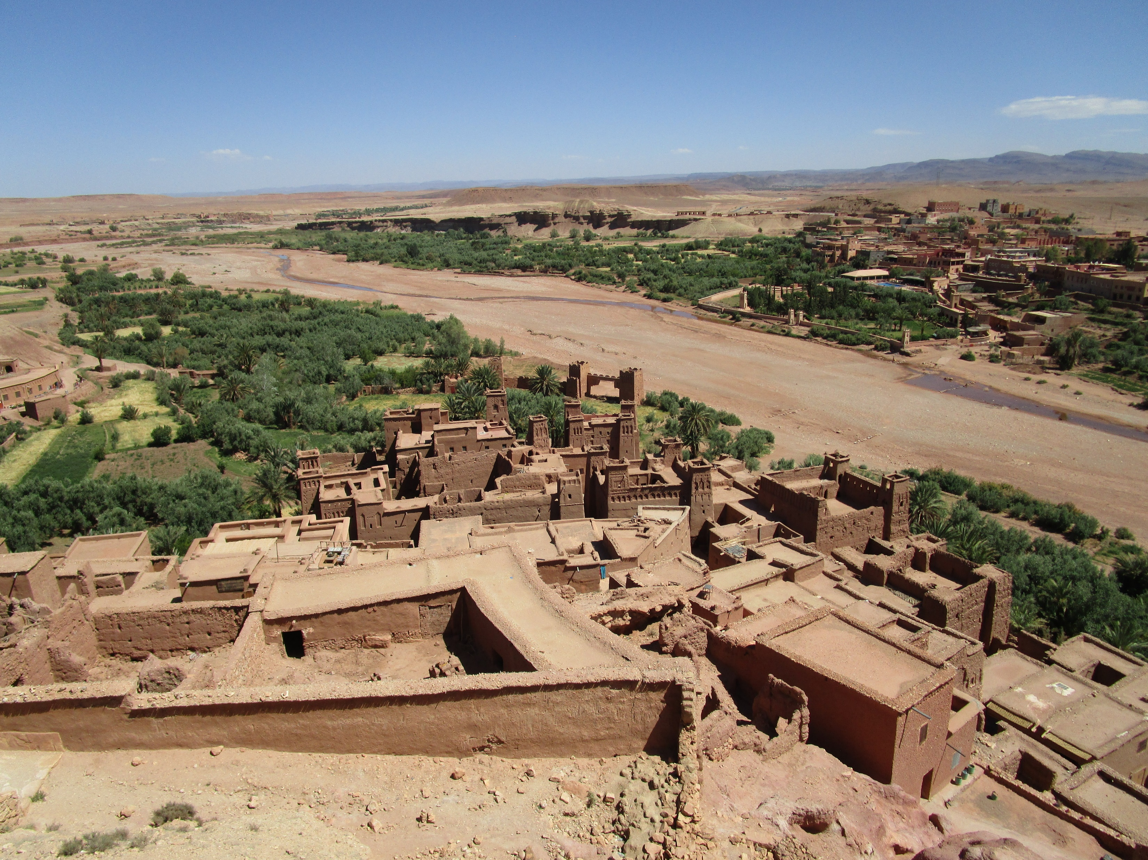
RURAL HERITAGE- LANDSCAPES AND BEYOND PATRIMOINE RURAL - PAYSAGES ET AU-DELÀ
Connecting Practice Case Studies
Gwenaëlle Bourdin, Kristal Buckley, Leanna Wigboldus
ICOMOS Advisory Committee Scientific Symposium
Symposium scientifique du Conseil consultatif de l’ICOMOS
17 October 2019 at Marrakesh, Morocco
17 octobre 2019 à Marrakech, Maroc

Slide 2
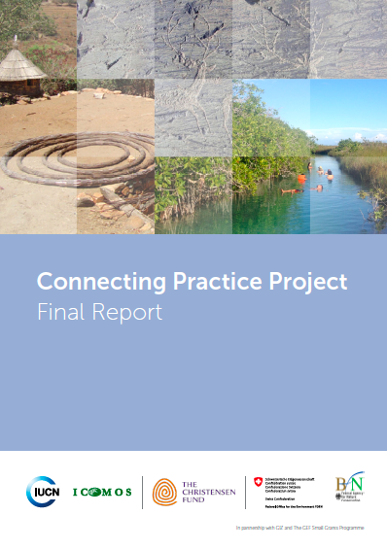
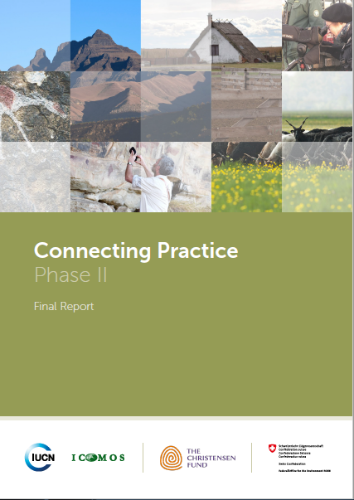
https://www.iucn.org/theme/world-heritage/our-work/global-world-heritage-projects/connecting-nature-and-culture

Slide 3
PHASE I
2013 – 2015
PHASE II
2015 – 2017
PHASE III
2018 - 2020

Slide 4
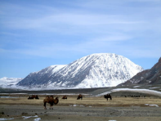
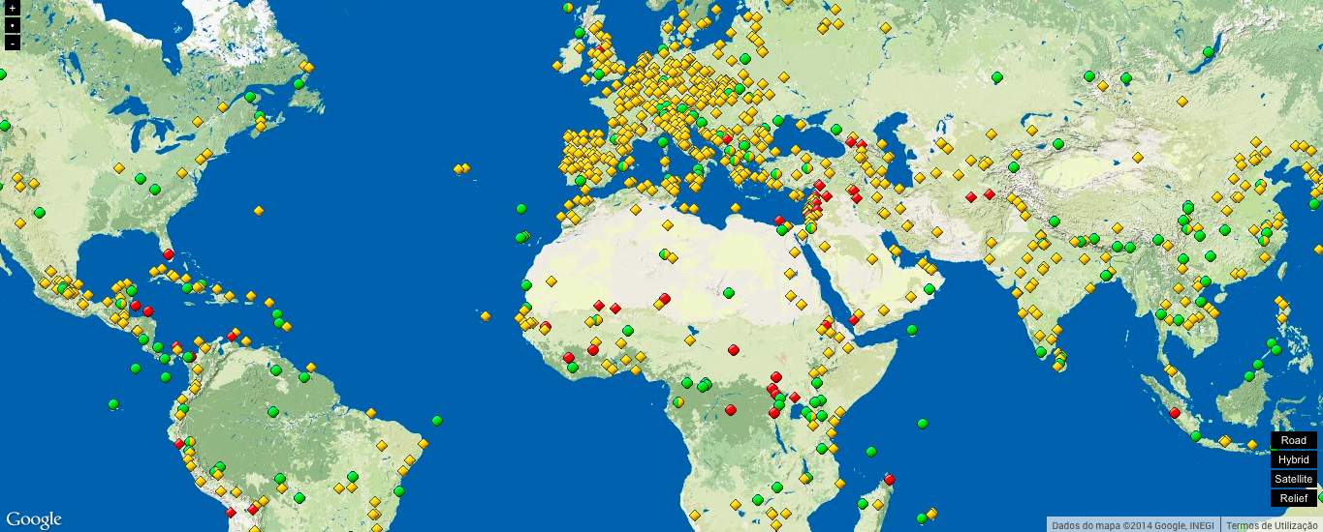
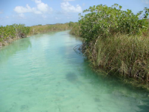
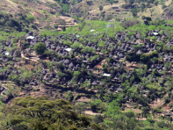
Connecting Practice – Phase I (2013 – 2015)
Petroglyphic Complexes of the Mongolian Altai
(Mongolia) October 2014
Sian Ka'an (Mexico)
January 2015
Konso Cultural Landscape
(Ethiopia)
November 2014
Notes:
First phase of the project was focused on exploring IUCN/ICOMOS working methods and organizational cultures
It underlined the need for:
Joint briefing of the teams and preparation for the site visit;
Collaboration amongst team members and between them and local colleagues;
Applying holistic approach to the interconnected character of the natural, cultural and social values of the property;
Guidance on approaches to linking nature and culture in the management of sites.

Slide 5
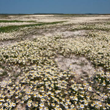
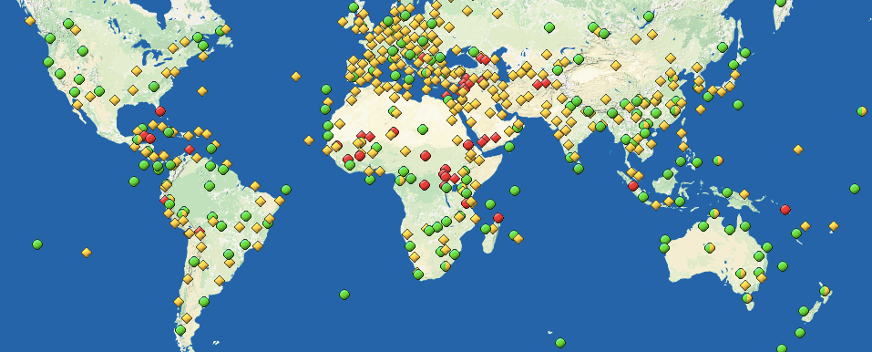
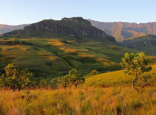
Connecting Practice – Phase II (2015 – 2017)
Hortobágy National Park - the Puszta
(Hungary)
October 2016 & February 2017
Maloti-Drakensberg Park
(South Africa)
July 2016 & March 2017
Notes:
Second phase of the project translated lessons learned from the first phase into practical interventions
Select two contrasting landscapes/seascapes which are regionally and typologically diverse, and complement those used in the first phase of the project for fieldwork study;
Work in close partnership with local and national management authorities to develop and strengthen policy and management frameworks to achieve long­-term conservation;
Explore and define practical strategies to adapt management effectiveness methodologies which recognize the interdependence of biological and cultural diversity.

Slide 6
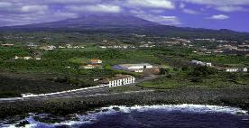
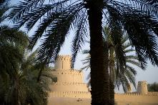
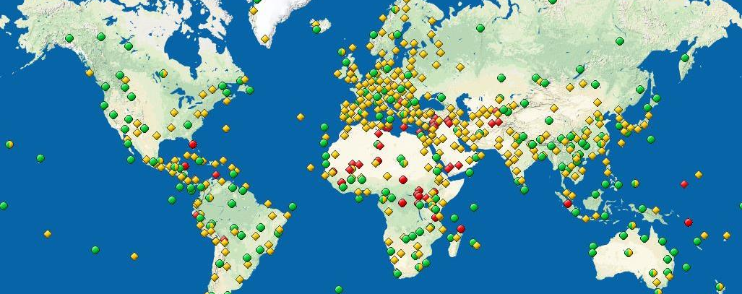
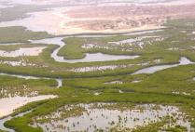
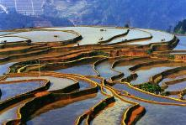
Connecting Practice – Phase III (2017 – Present)
Landscape of the Pico Island Vineyard Culture (Portugal)
September 2019
Cultural Sites of Al Ain
(United Arab Emirates)
November 2018
Saloum Delta (Senegal)
December 2018
Cultural Landscape of Honghe Hani Rice Terraces (China)
November 2019
Notes:
Third phase of the project
Focuses specifically on organically-evolved cultural landscapes, including landscapes for agriculture, but also fishing and shellfish gathering;
Explores how to best support and sustain traditional management practices within the processes of the World Heritage framework to achieve long-term conservation;
Develops a better understanding of how to strengthen the resilience of sites by studying the changes affecting them;
This phase also includes cooperation with the FAO and their program on ‘Globally Important Agricultural Heritage Systems’ (GIAHS).

Slide 7
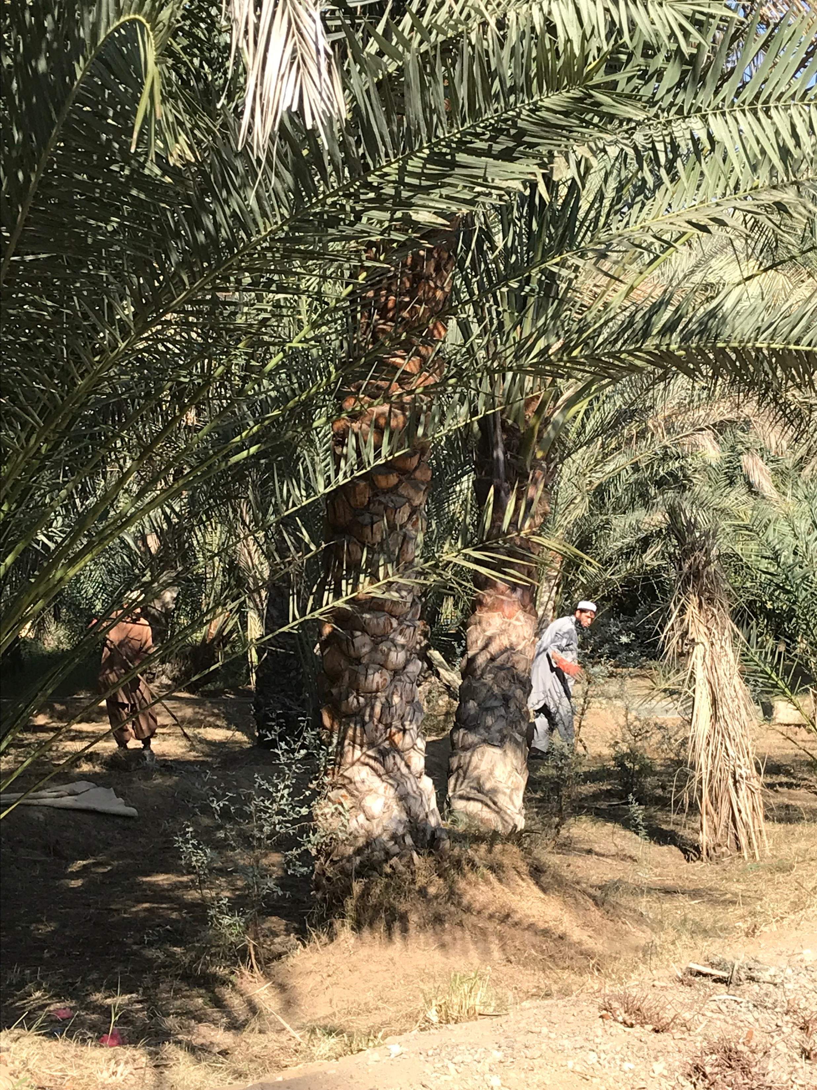
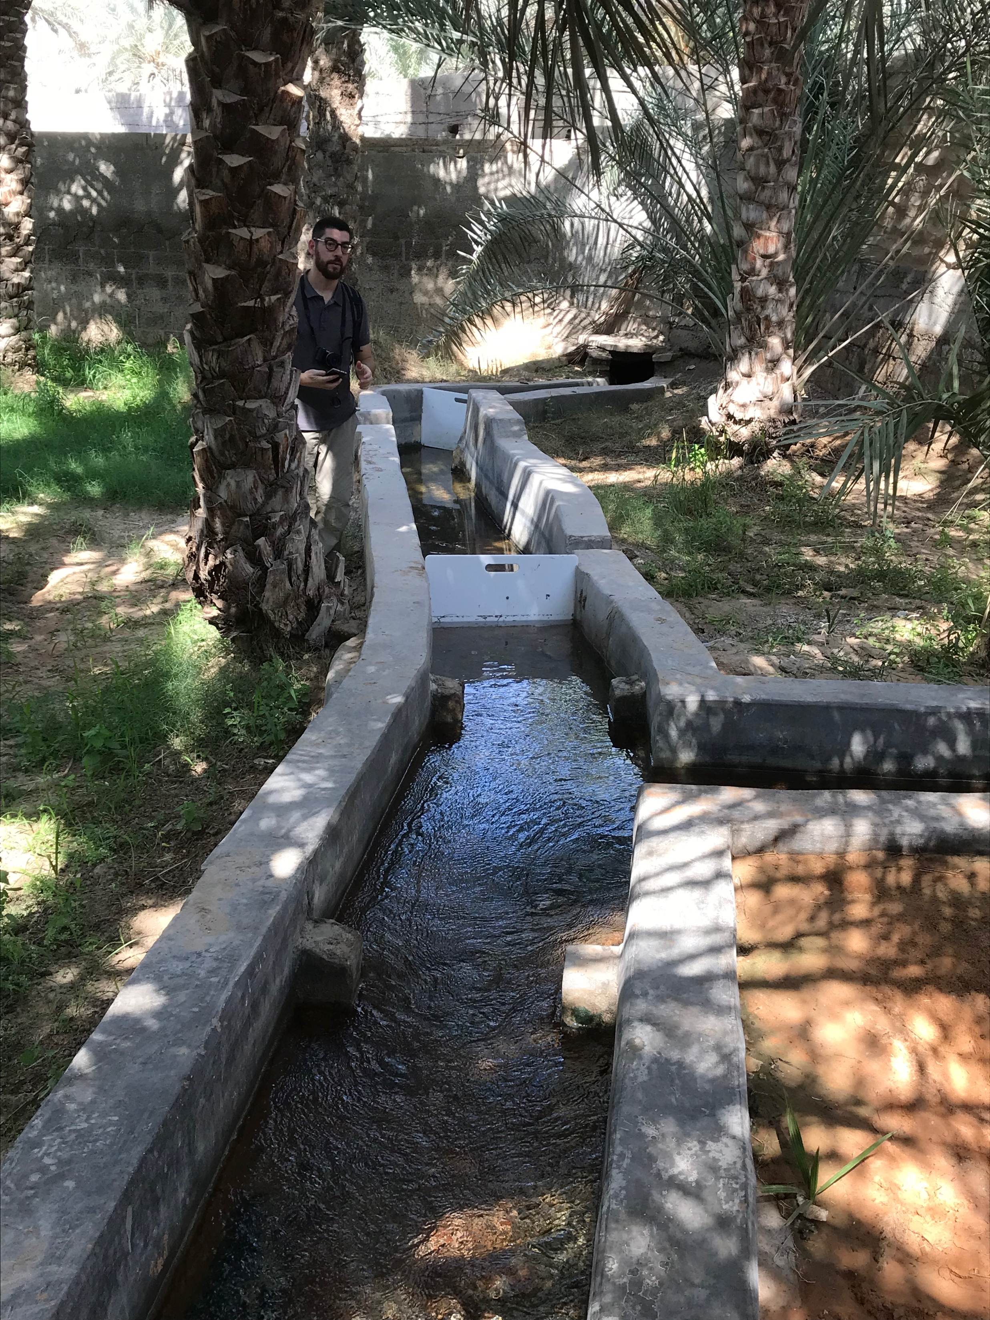
Cultural Sites of Al Ain (United Arab Emirates)

Slide 8
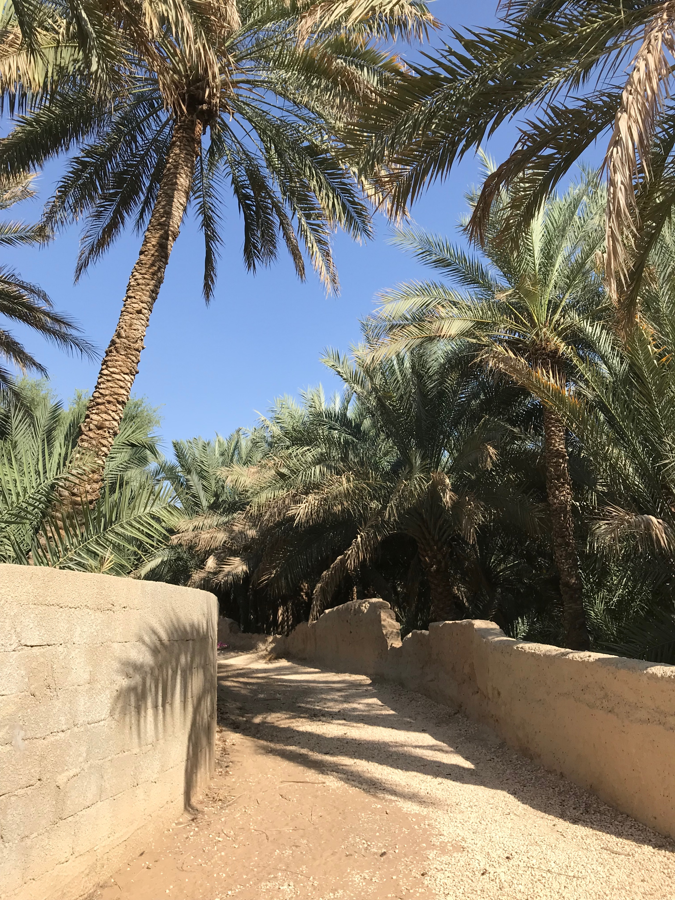
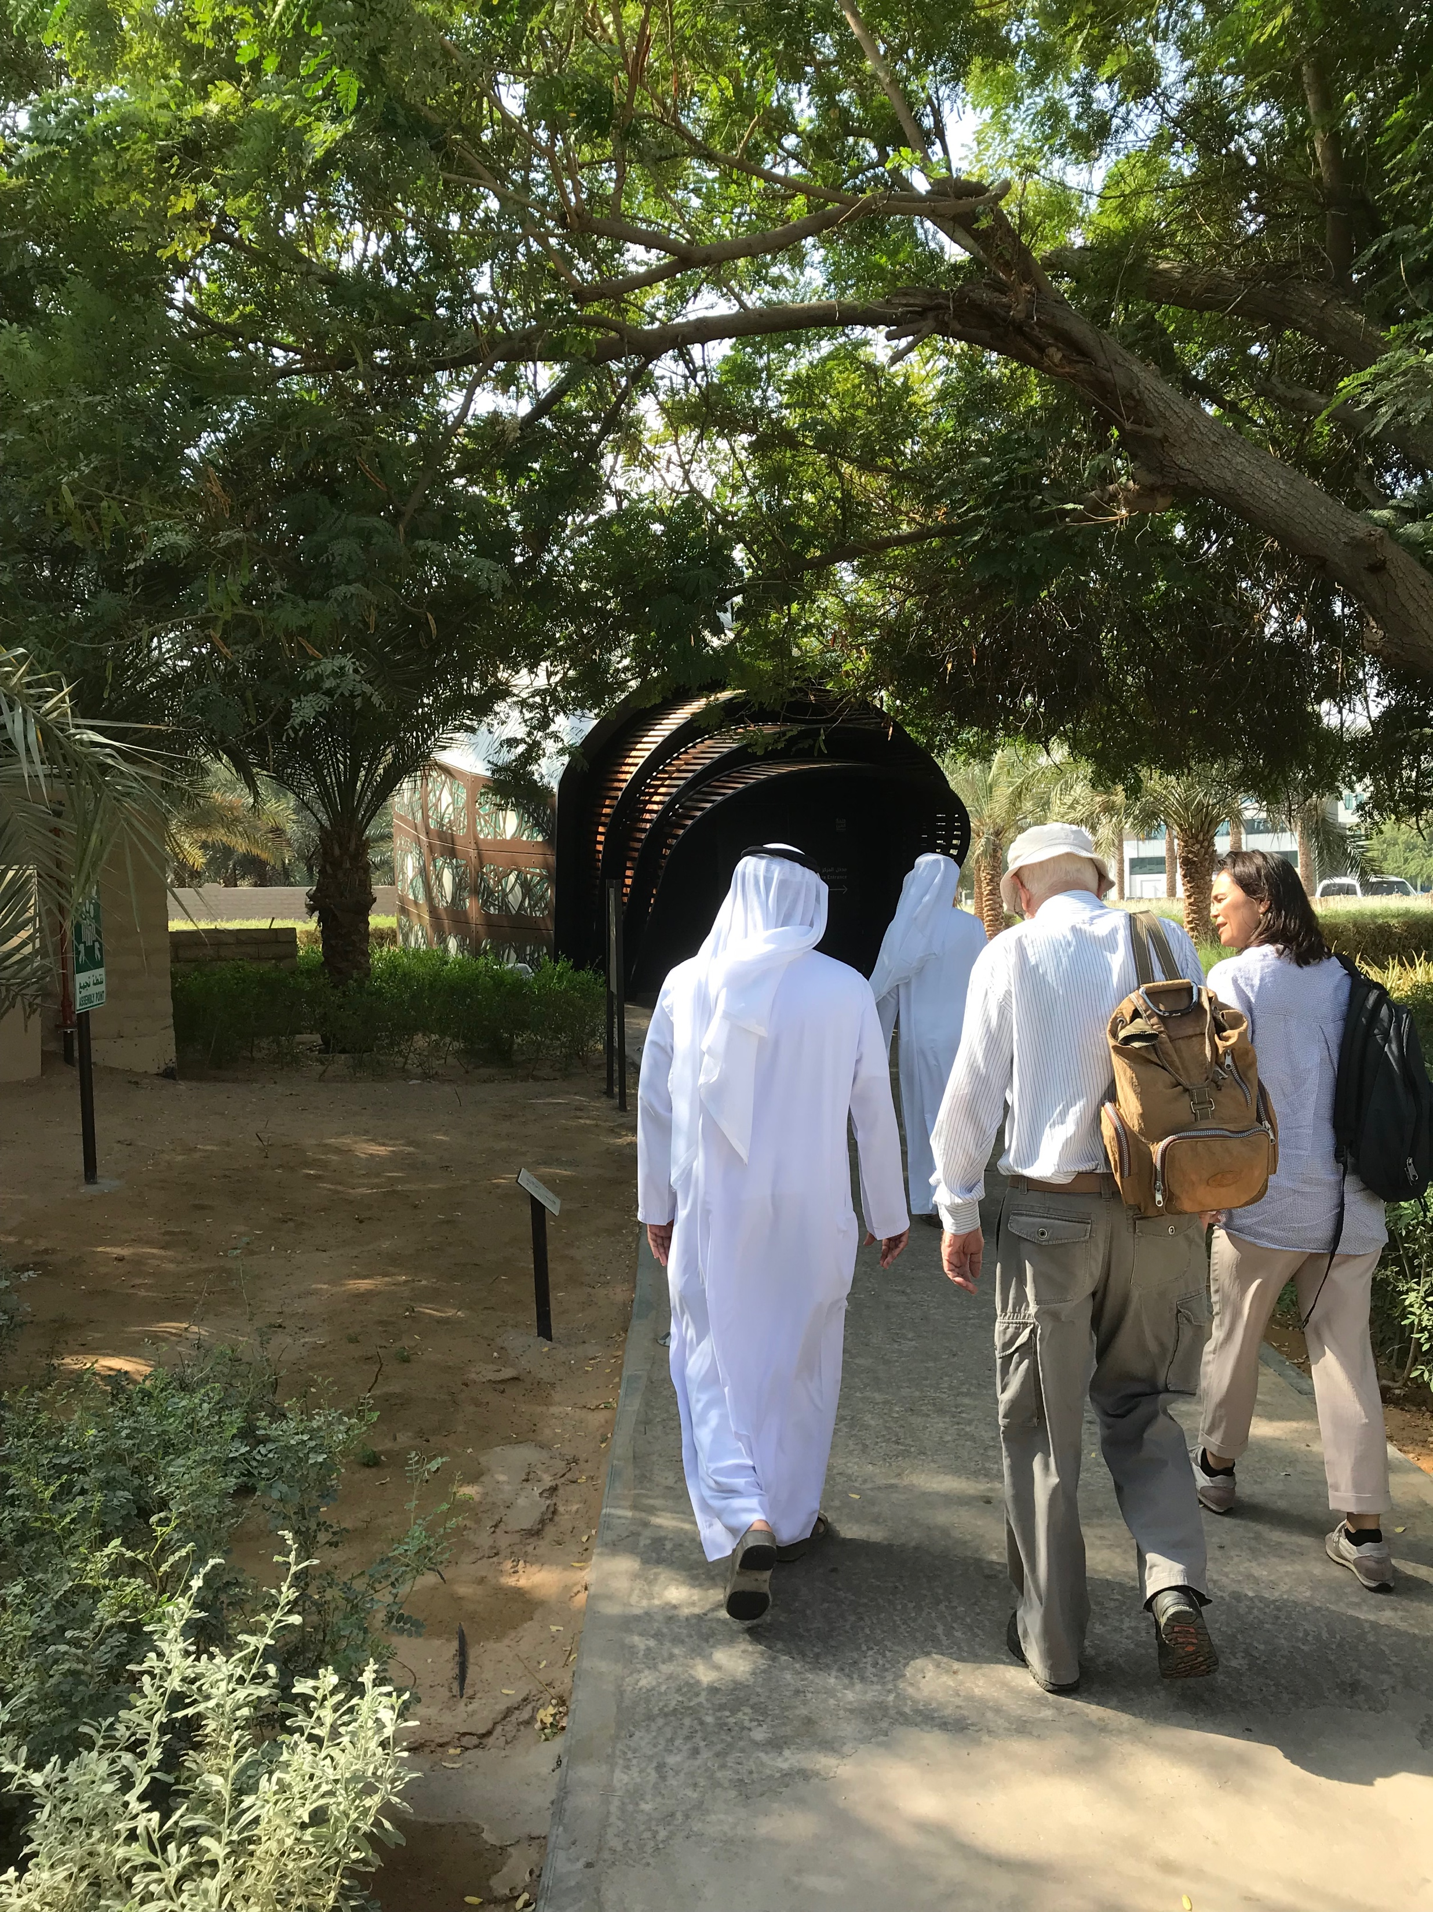

Slide 9
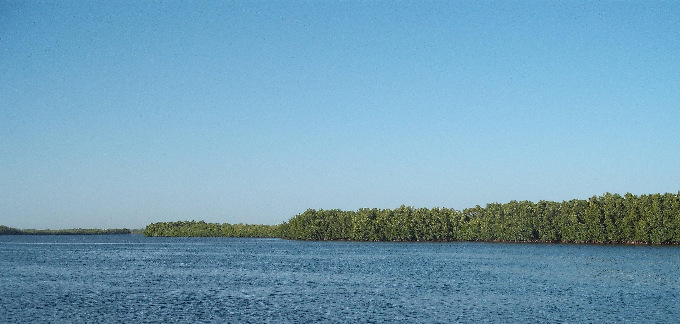
Saloum Delta (Senegal)

Slide 10
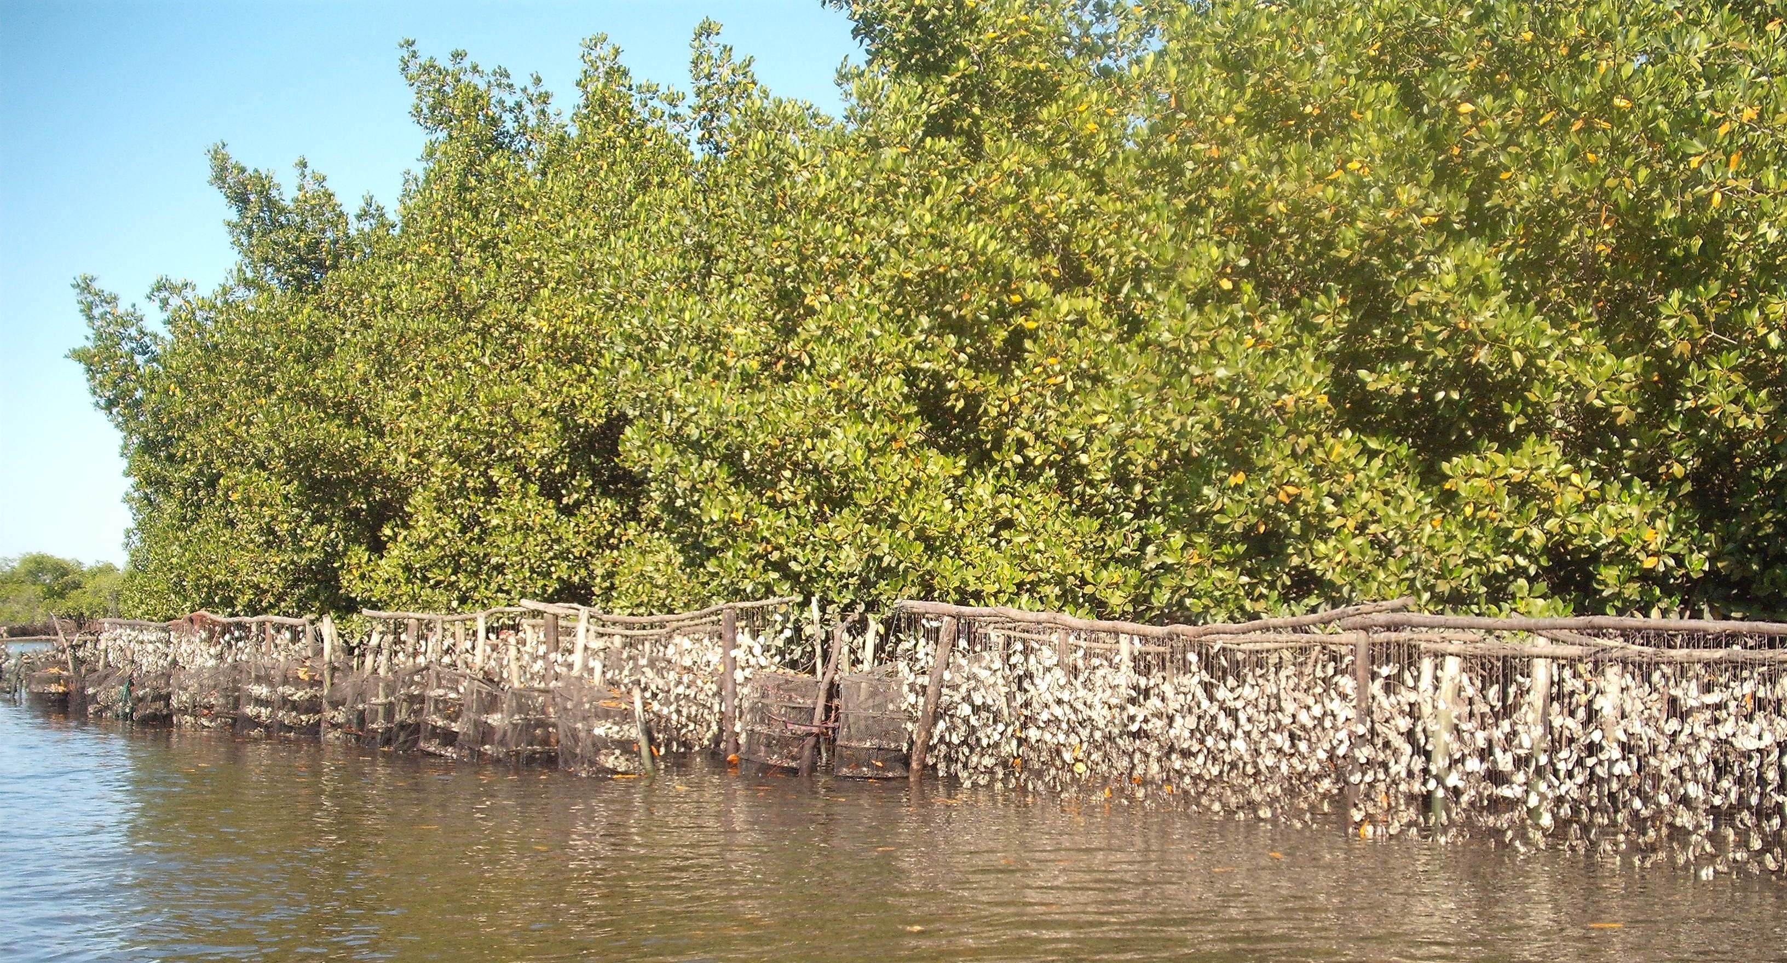

Slide 11
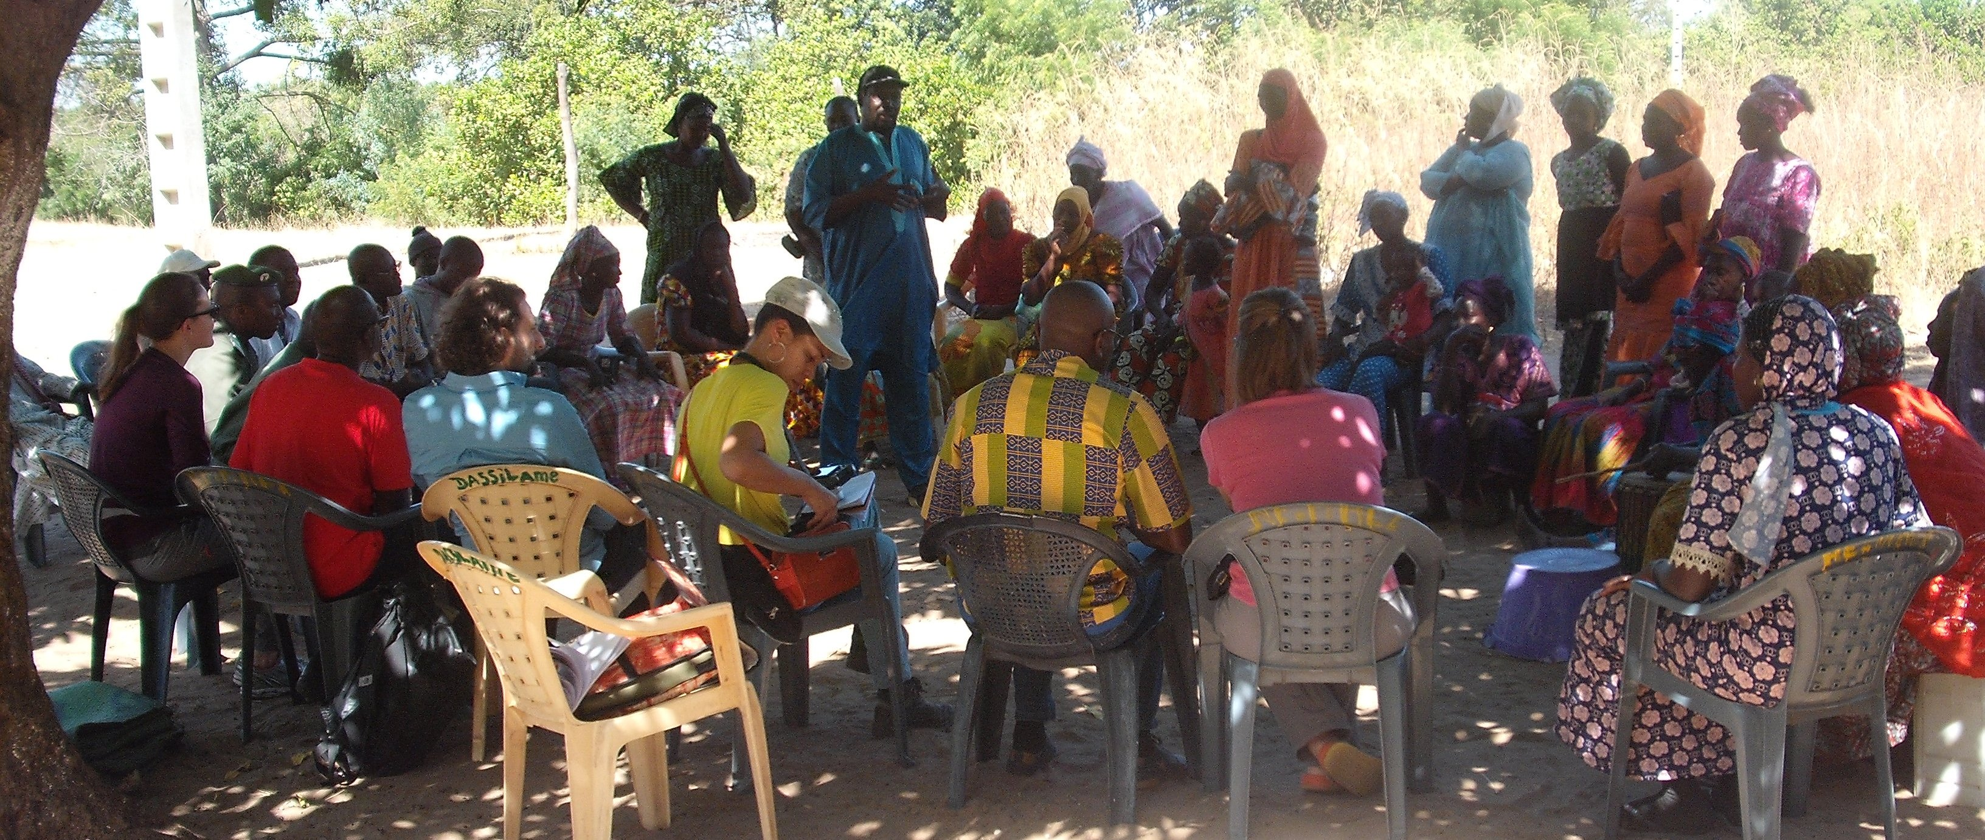

Slide 12
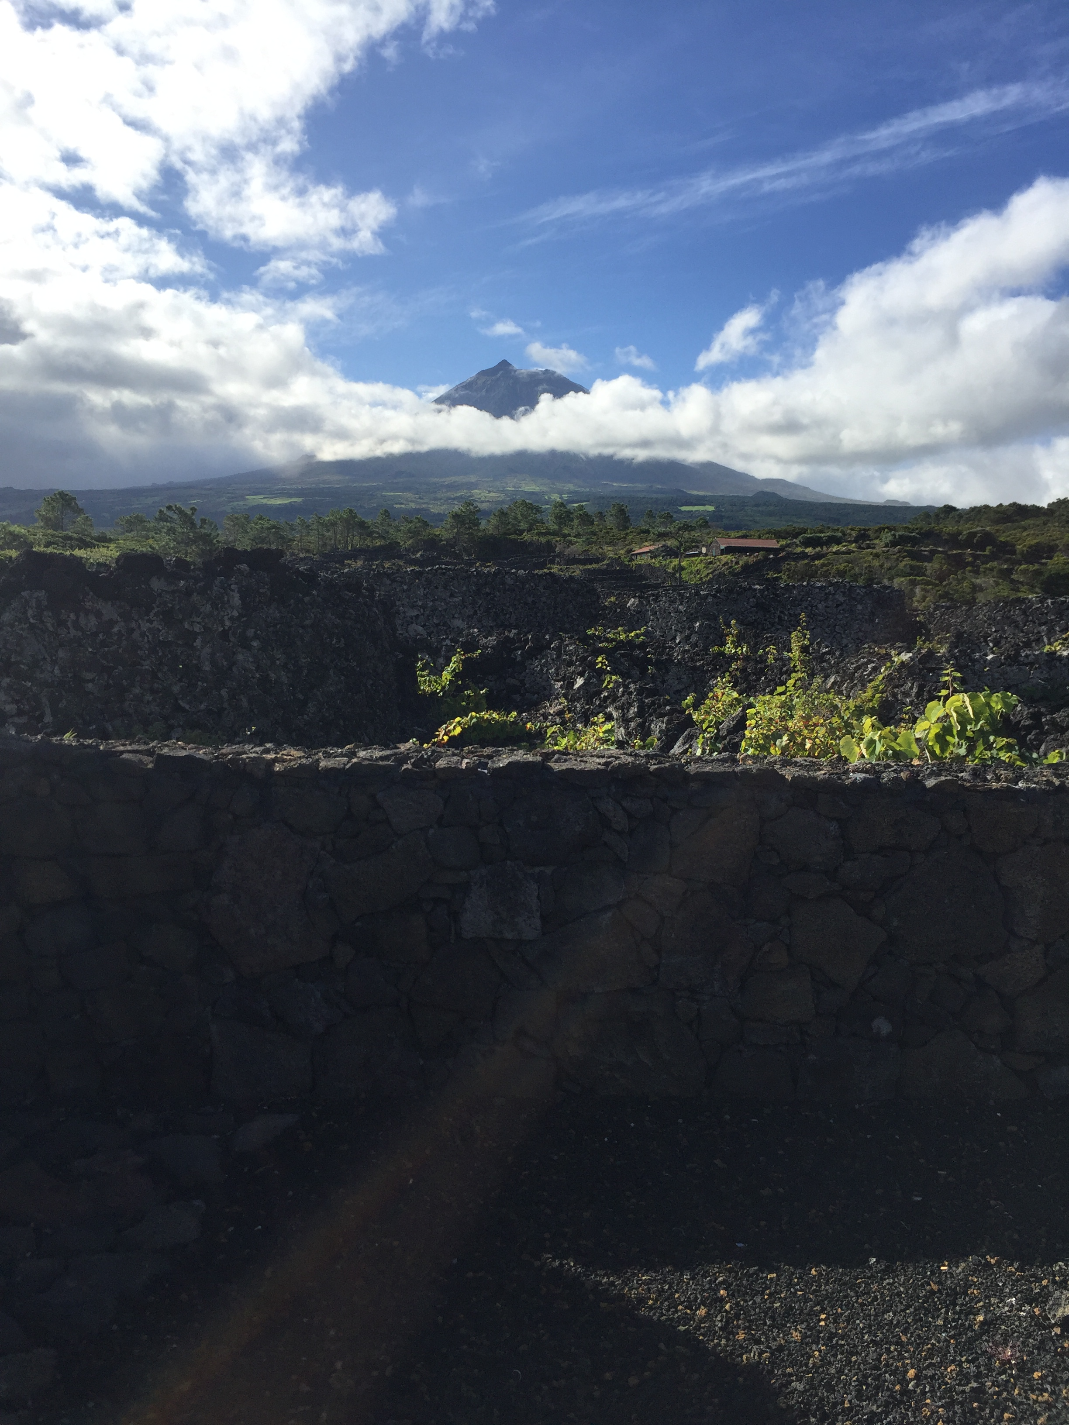
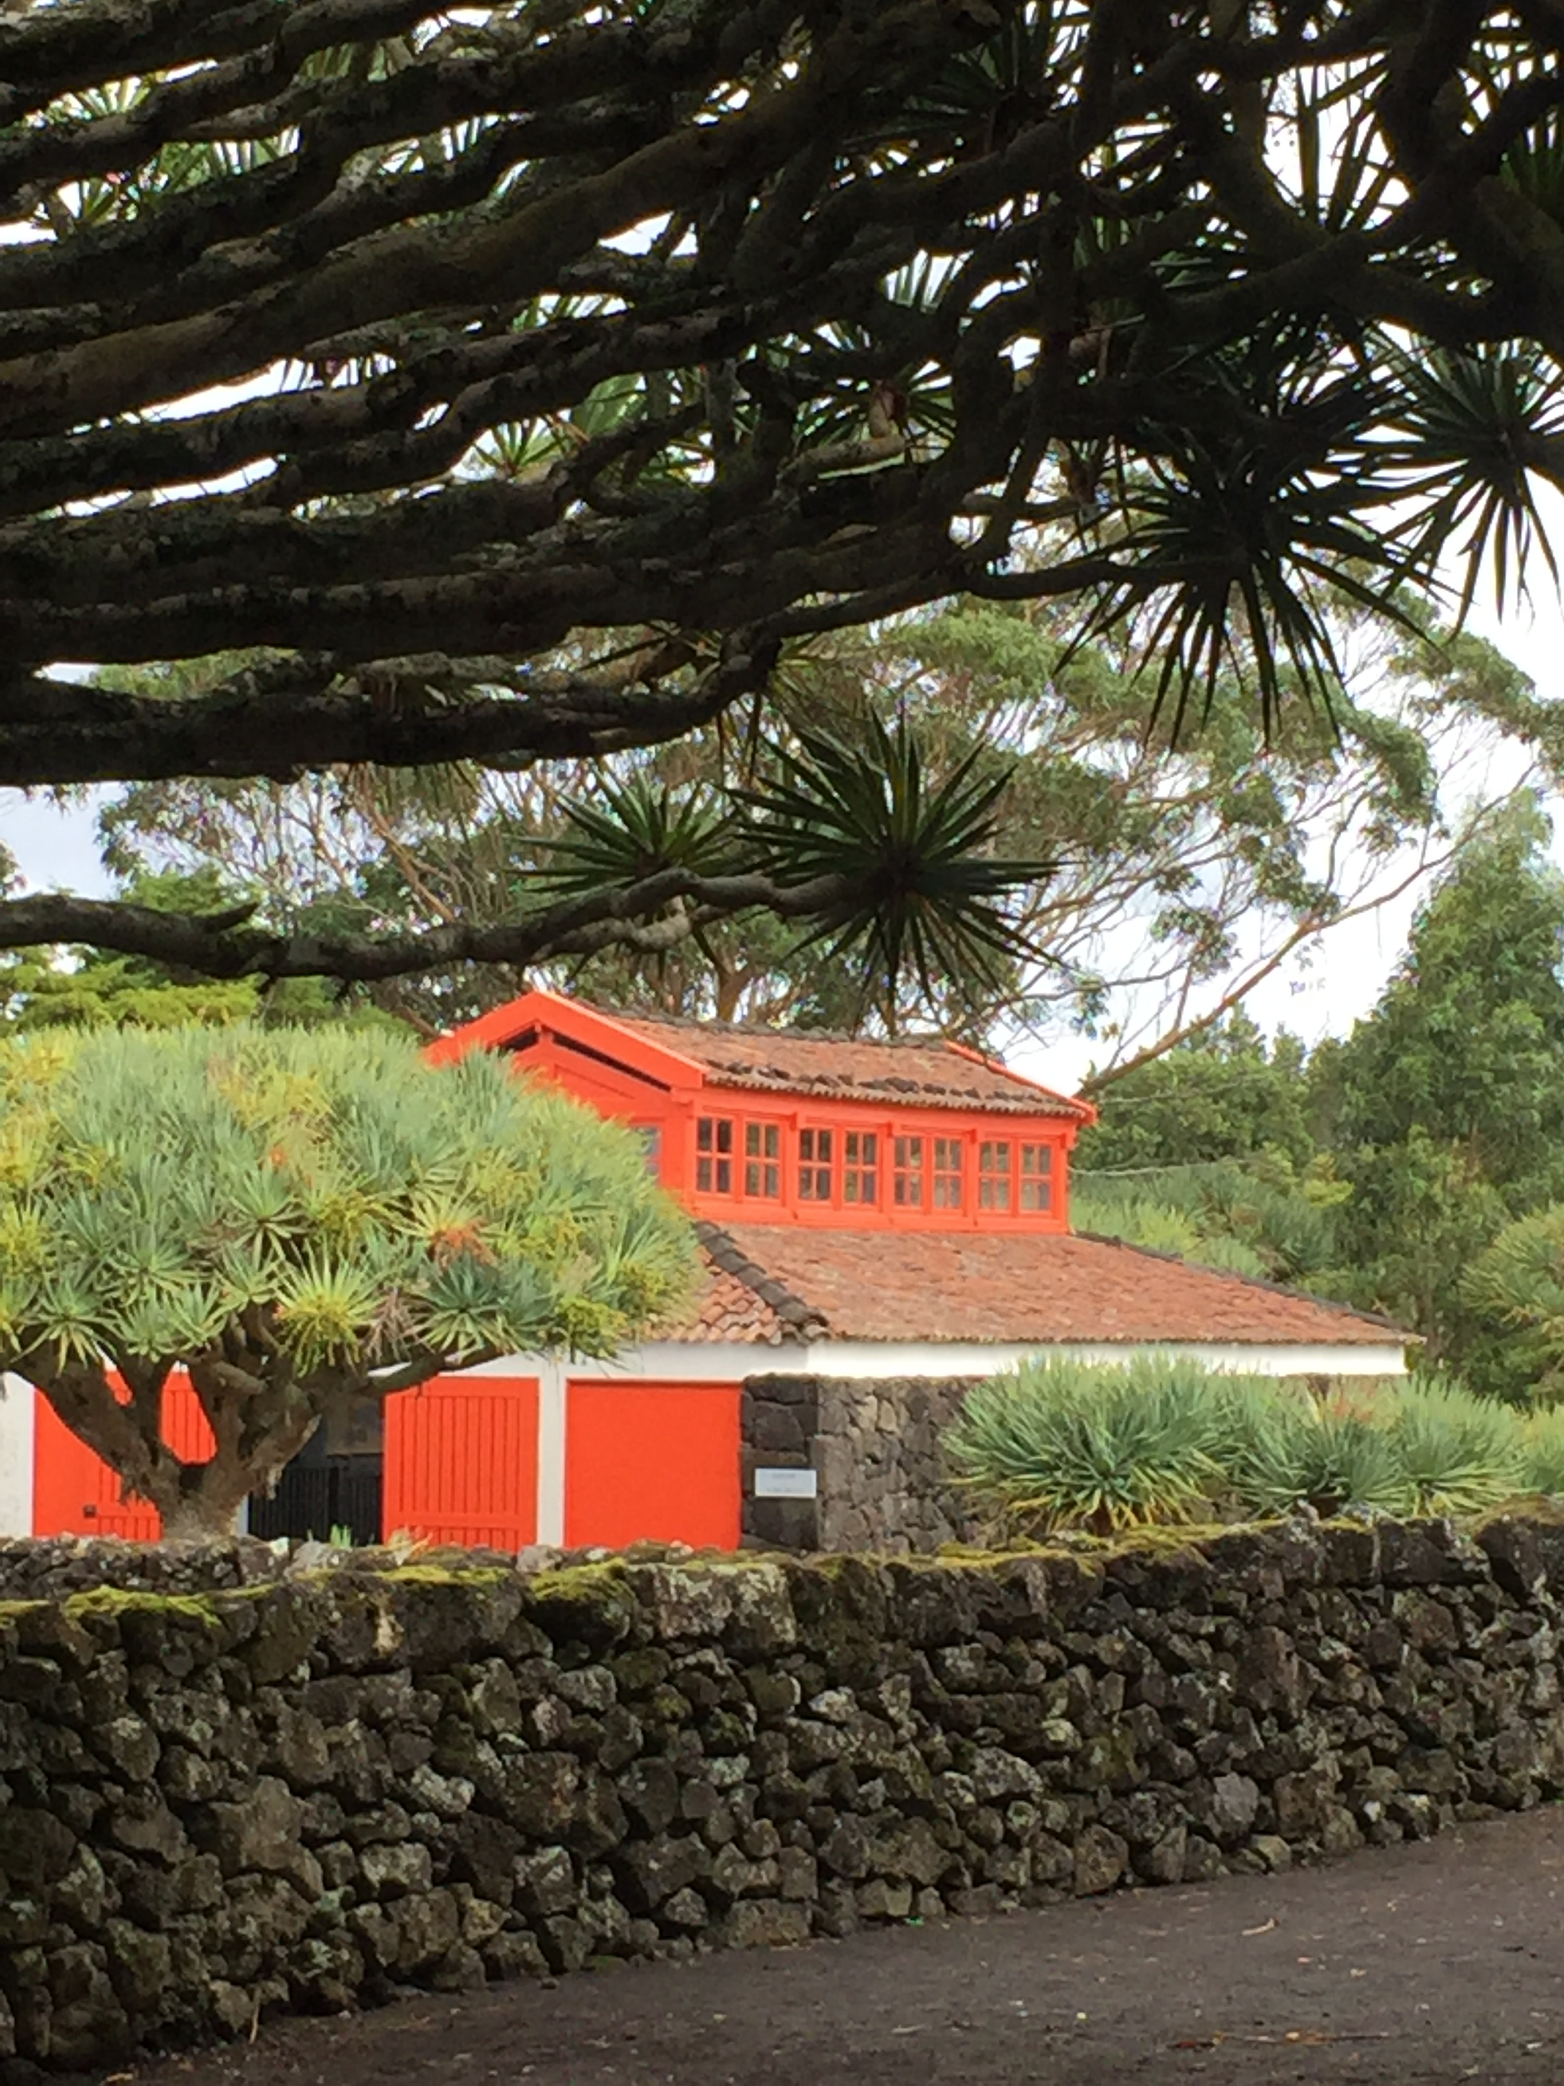
Landscape of the Pico Island Vineyard Culture (Portugal)

Slide 13
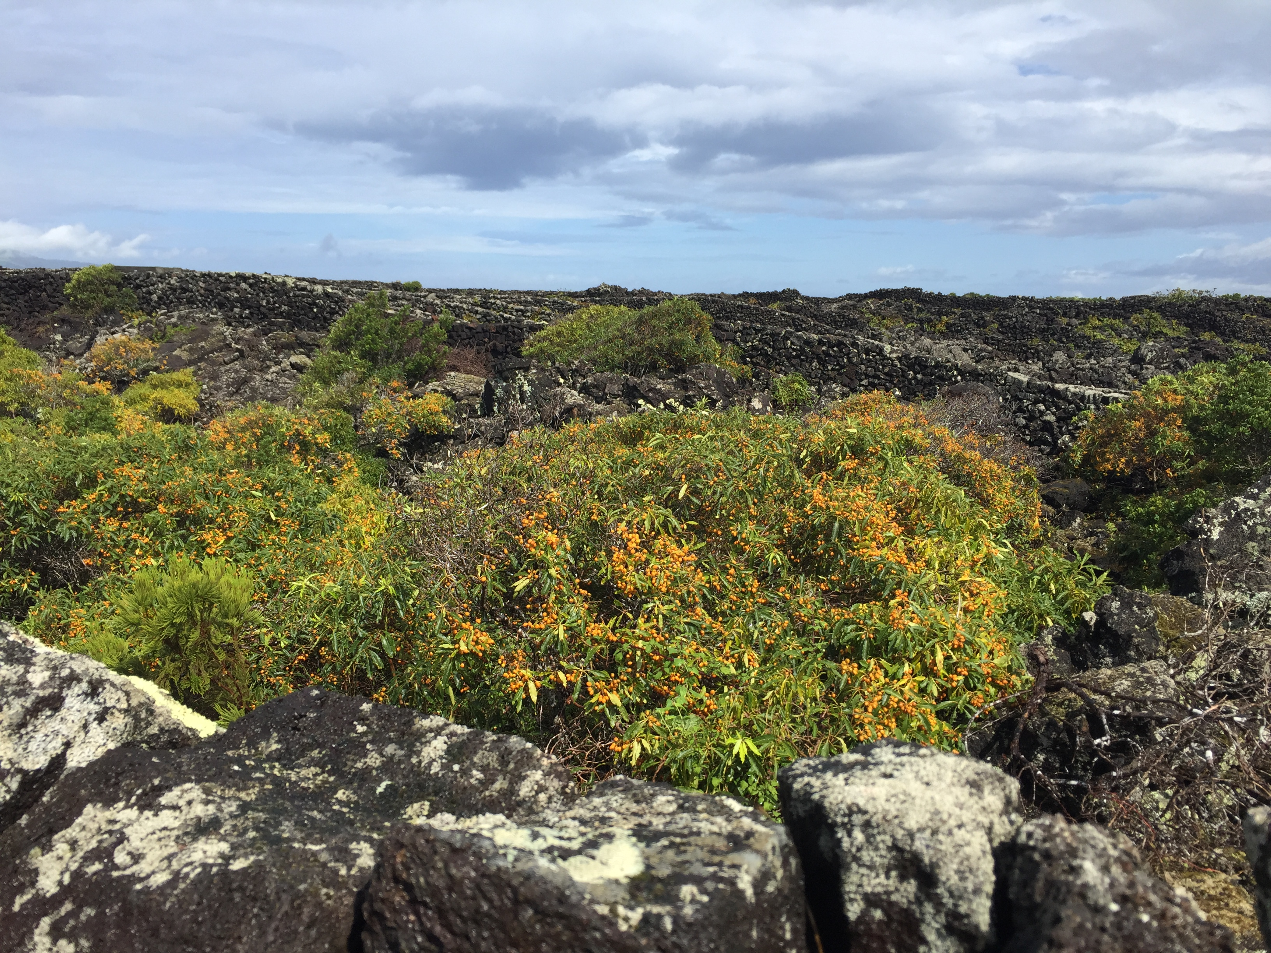

Slide 14
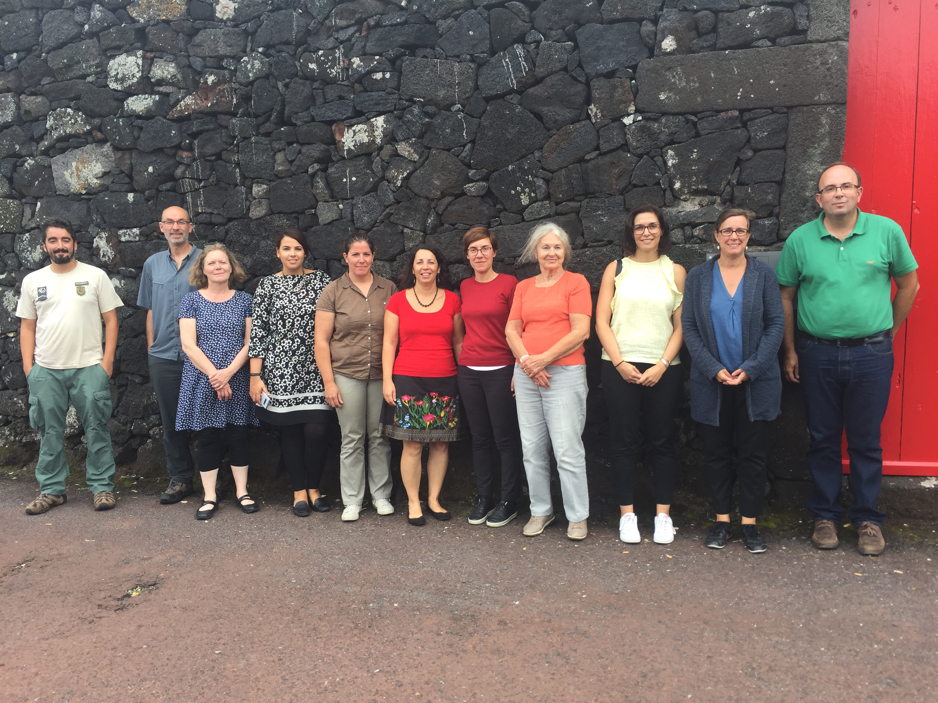

Slide 15
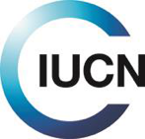
Connecting
Practice
PRACTICE

